Slide 1
CS639: Data Management for Data Science
Midterm Review 2: MapReduce and NoSQL
Theodoros Rekatsinas

Slide 2
Today’s Lecture
Review Relational Databases and Relational Algebra
Next Lecture: Review MapReduce and NoSQL systems

Slide 3
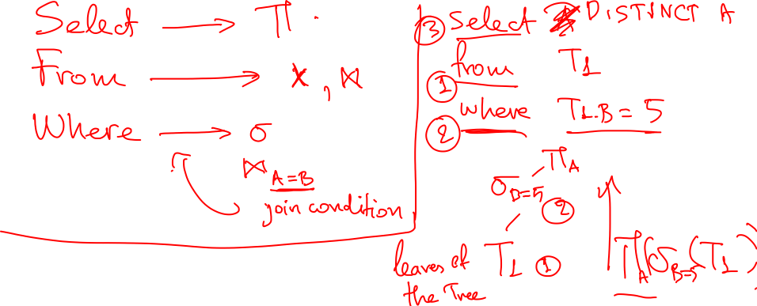


Slide 4
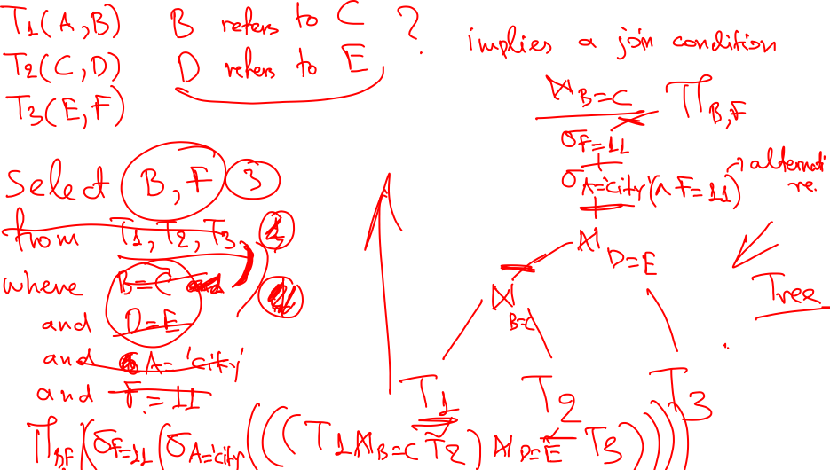

Slide 5


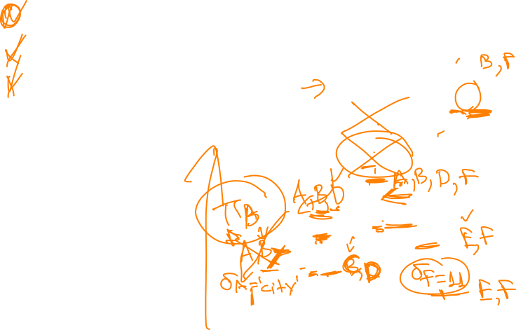


Slide 6
The Map Reduce Abstraction for Distributed Algorithms
Distributed Data Storage
Map
(Shuffle)
Reduce

Slide 7
The Map Reduce Abstraction for Distributed Algorithms
Distributed Data Storage
map
map
map
map
map
map
Map
(Shuffle)
reduce
reduce
reduce
reduce
Reduce

Slide 8
The Map Reduce Abstraction for Distributed Algorithms
Distributed Data Storage
map
map
map
map
map
map
Map
(Shuffle)
reduce
reduce
reduce
reduce
Reduce

Slide 9
Map
Reduce
Shift
(docID=1, v1)
(docID=2, v2)
(docID=3, v3)
….
(w1, 1)
(w2, 1)
(w3, 1)
(w1, [1, 1, …])
(w2, [1, 1,…])
(w3, [1, …])
(w1, 73)
(w2, 31)
(w3, 15)
(w1, 1)
(w2, 1)
…
…

Slide 10
The Map Reduce Abstraction for Distributed Algorithms
MapReduce is a high-level programming model and implementation for large-scale parallel data processing
Like RDBMS adopt the the relational data model, MapReduce has a data model as well

Slide 11
MapReduce’s Data Model
Files!
A File is a bag of (key, value) pairs
A bag is a multiset
A map-reduce program:
Input: a bag of (inputkey, value) pairs
Output: a bag of (outputkey, value) pairs

Slide 12
User input
All the user needs to define are the MAP and REDUCE functions
Execute proceeds in multiple MAP – REDUCE rounds
MAP – REDUCE = MAP phase followed REDUCE

Slide 13
MAP Phase
Step 1: the MAP phase
User provides a MAP-function:
Input: (input key, value)
Output: bag of (intermediate key, value)
System applies the map function in parallel to all (input key, value) pairs in the input file

Slide 14
REDUCE Phase
Step 2: the REDUCE phase
User provides a REDUCE-function:
Input: (intermediate key, bag of values)
Output: (intermediate key, values)
The system will group all pairs with the same intermediate key, and passes the bag of values to the REDUCE function

Slide 15
MapReduce Programming Model
Input & Output: each a set of key/value pairs
Programmer specifies two functions:
map (in_key, in_value) -> list(out_key, intermediate_value)
Processes input key/value pair
Produces set of intermediate pairs
reduce (out_key, list(intermediate_value)) -> (out_key, list(out_values))
Combines all intermediate values for a particular key
Produces a set of merged output values (usually just one)

Slide 16
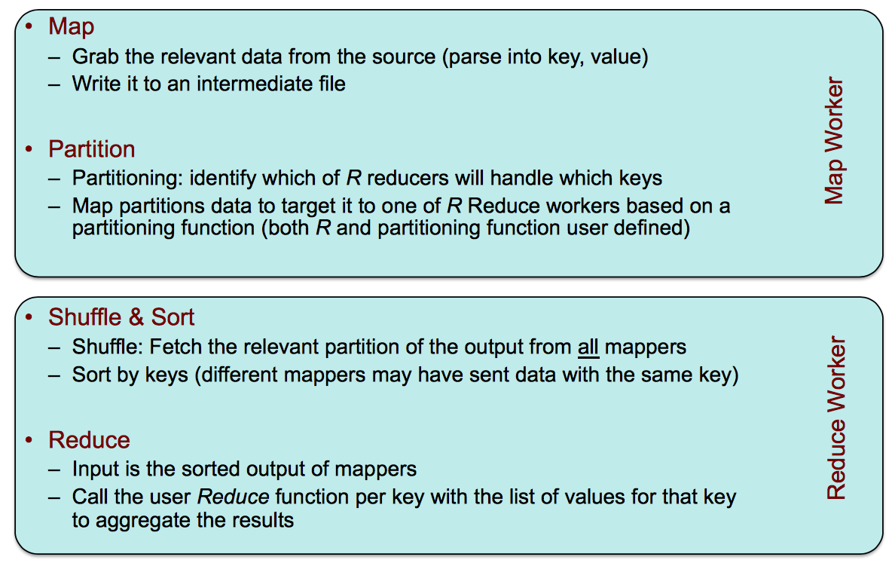
MapReduce: what happens in between?

Slide 17
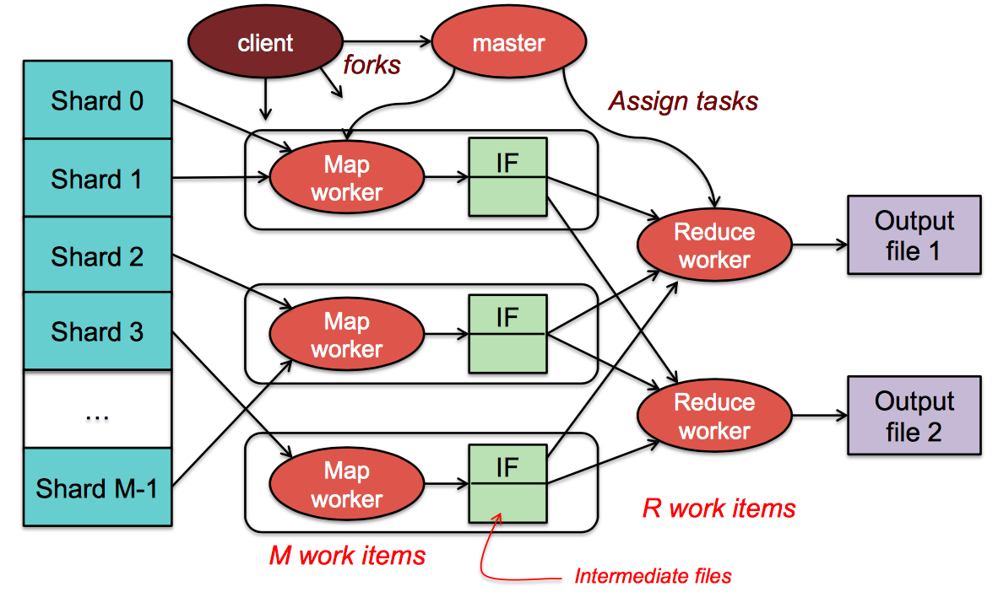
MapReduce: the complete picture

Slide 18
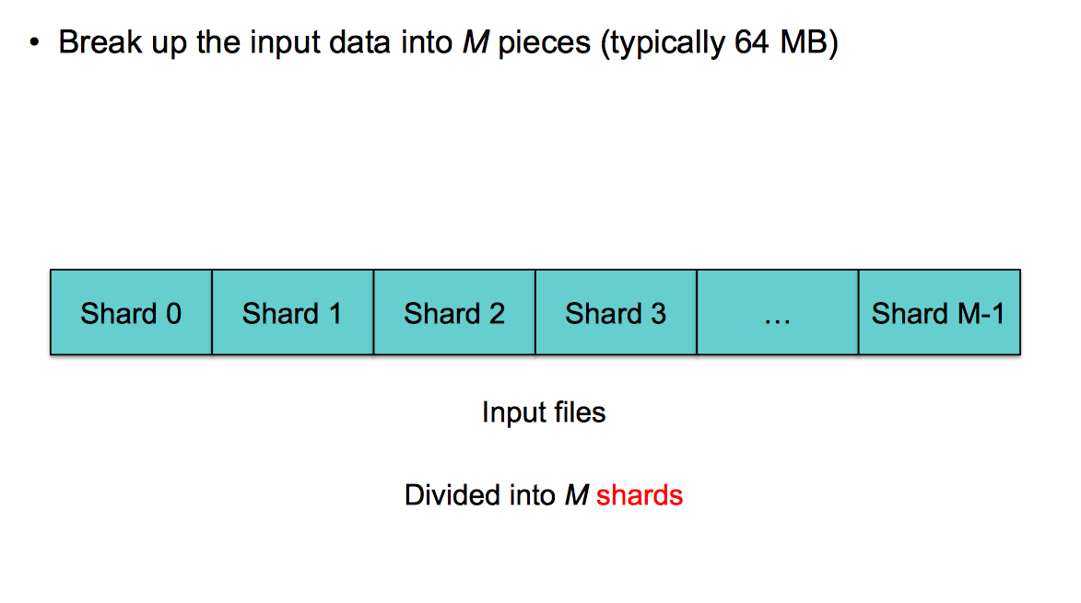
Step 1: Split input files into chunks (shards)

Slide 19
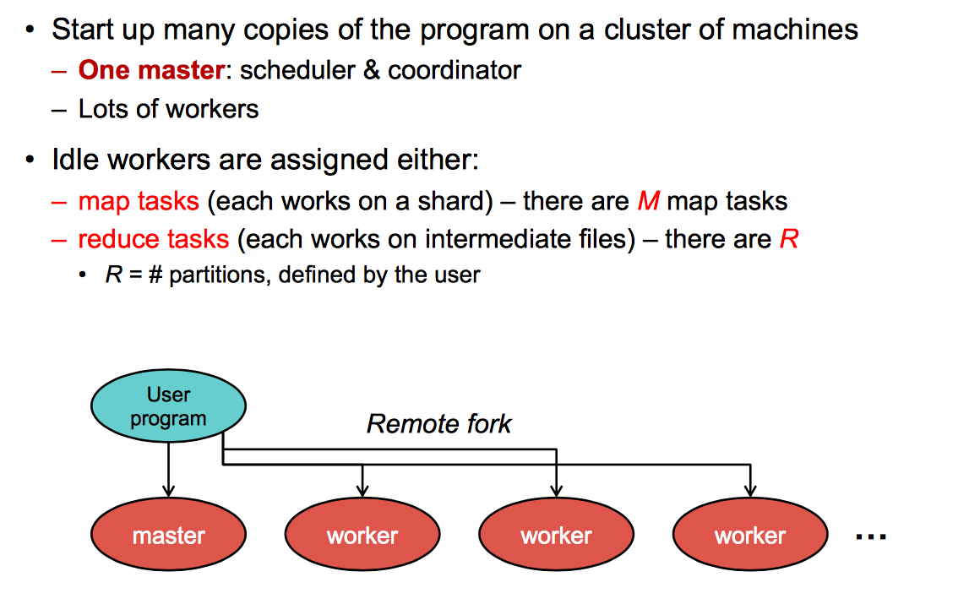
Step 2: Fork processes

Slide 20
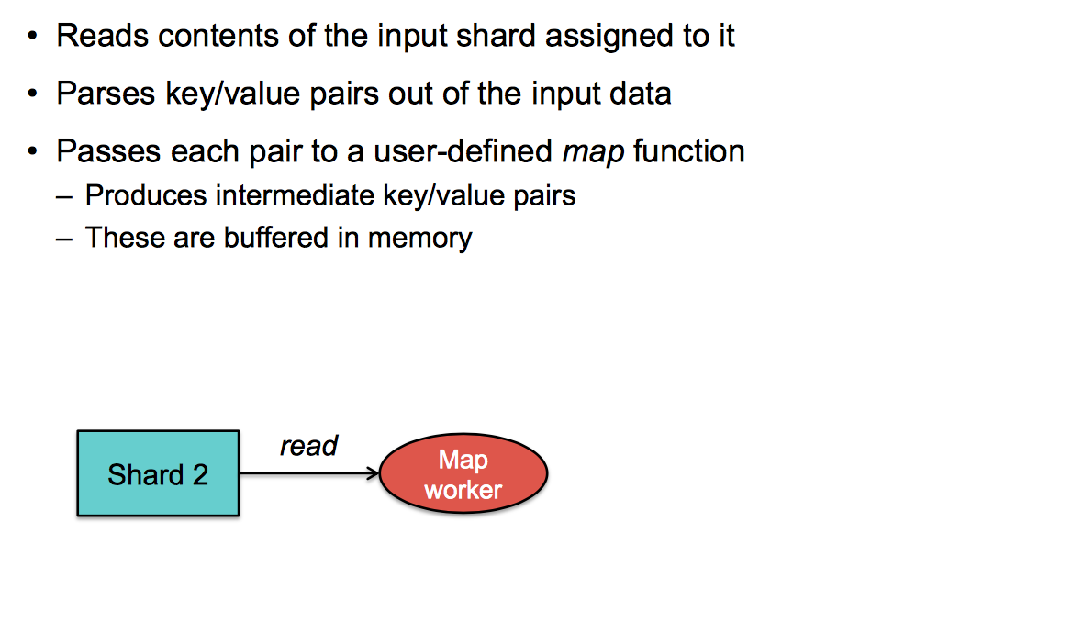
Step 3: Run Map Tasks

Slide 21
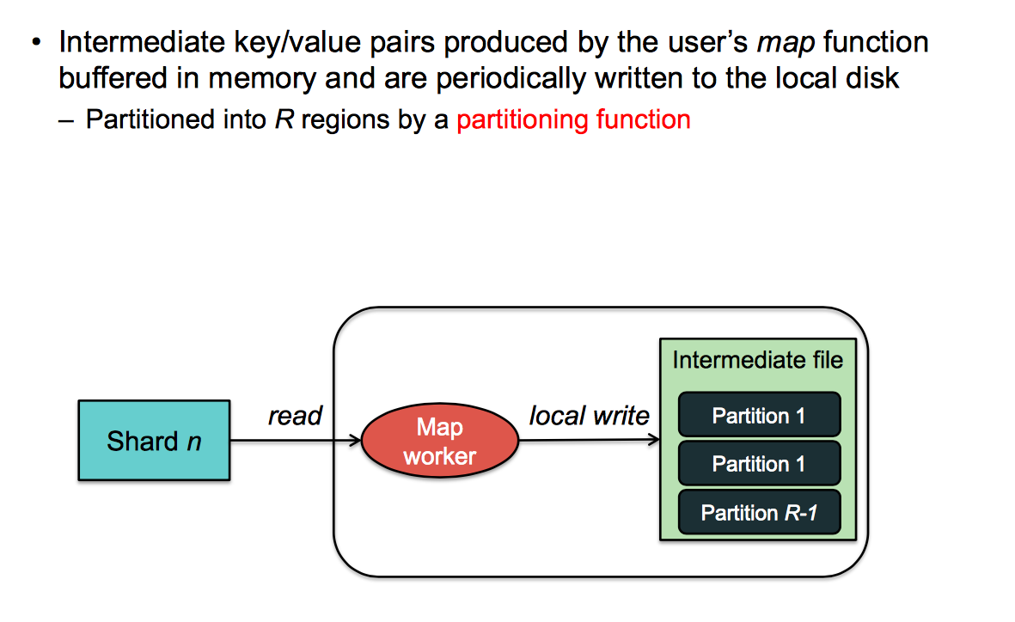
Step 4: Create intermediate files

Slide 22
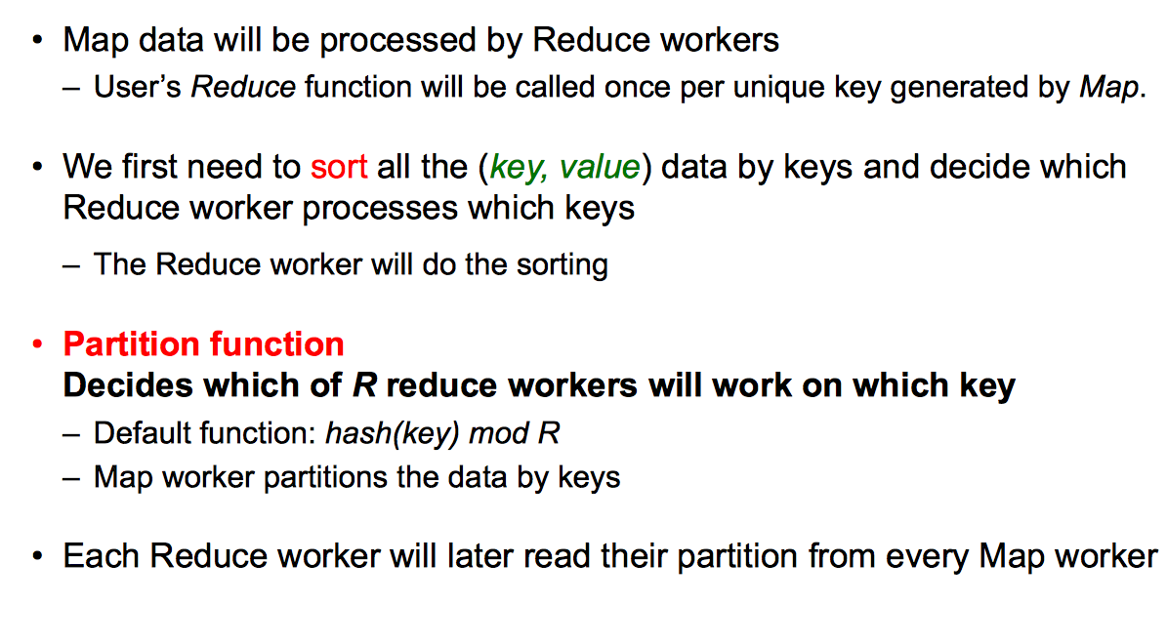
Step 4a: Partitioning

Slide 23
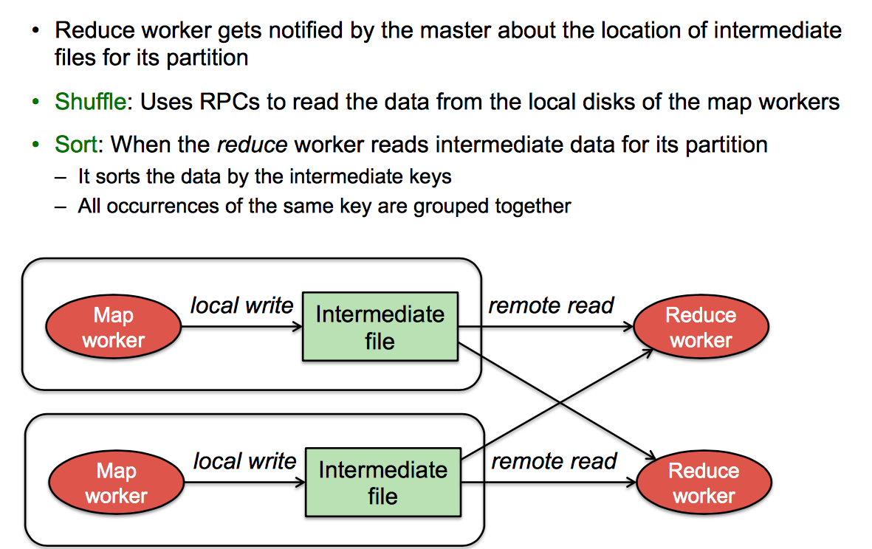
Step 5: Reduce Task - sorting

Slide 24
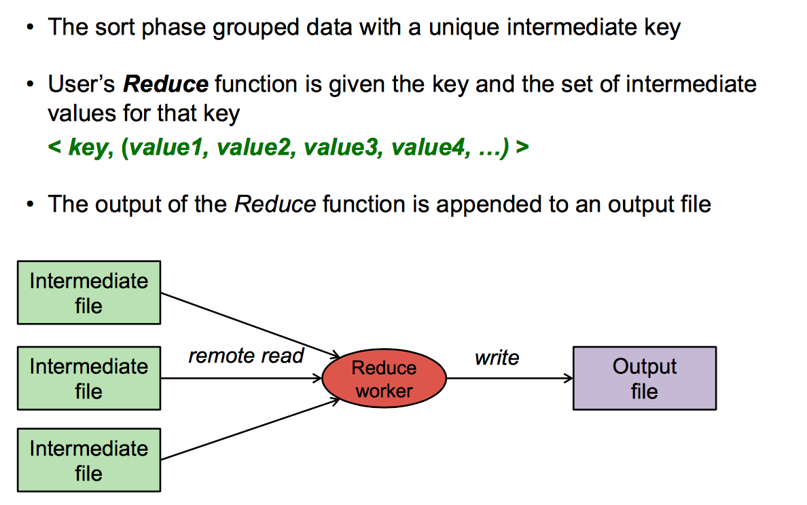
Step 6: Reduce Task - reduce

Slide 25
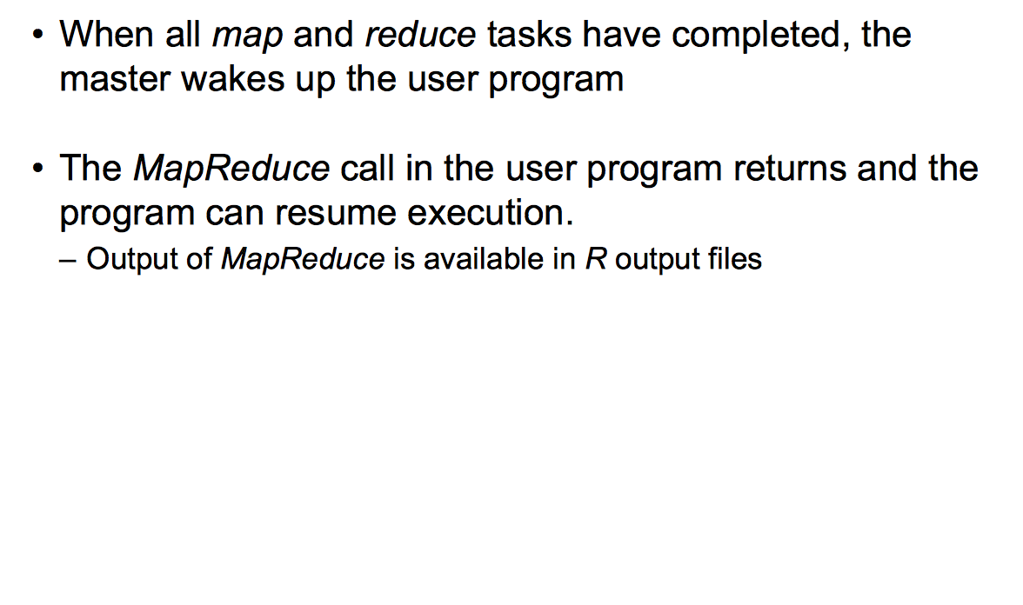
Step 7: Return to user

Slide 26
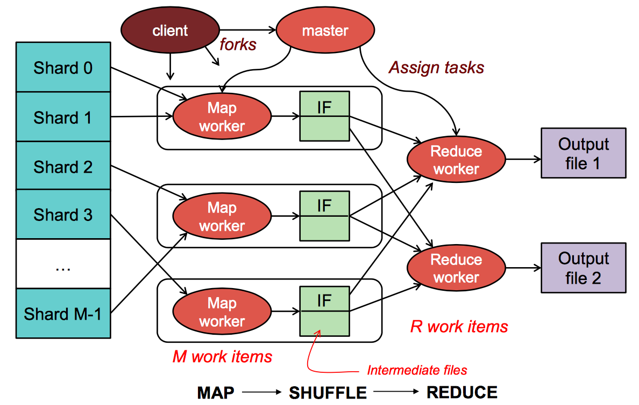
MapReduce: the complete picture
We need a distributed file system!

Slide 27
2. Spark

Slide 28
Intro to Spark
Spark is really a different implementation of the MapReduce programming model
What makes Spark different is that it operates on Main Memory
Spark: we write programs in terms of operations on resilient distributed datasets (RDDs).
RDD (simple view): a collection of elements partitioned across the nudes of a cluster that can be operated on in parallel.
RDD (complex view): RDD is an interface for data transformation, RDD refers to the data stored either in persisted store (HDFS) or in cache (memory, memory+disk, disk only) or in another RDD

Slide 29
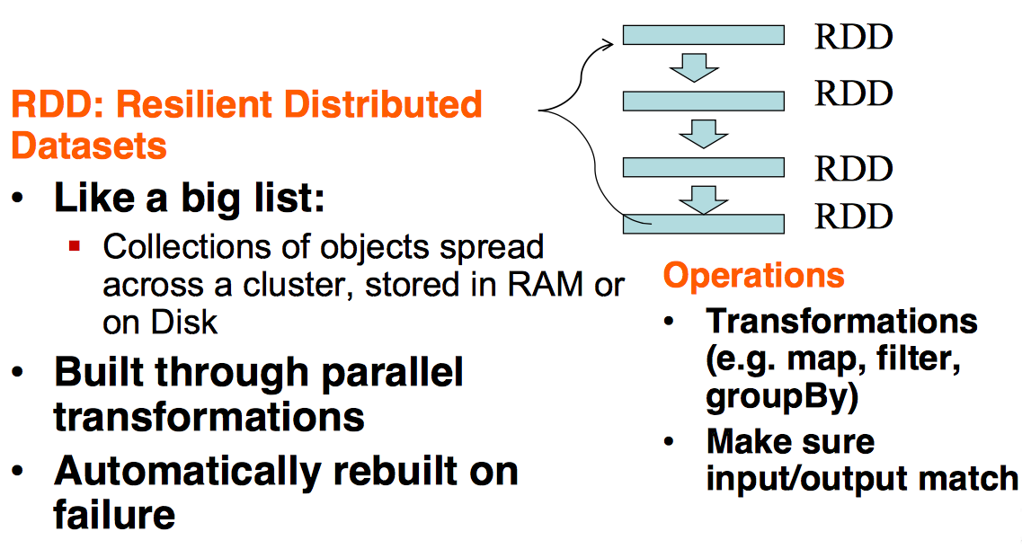
RDDs in Spark

Slide 30
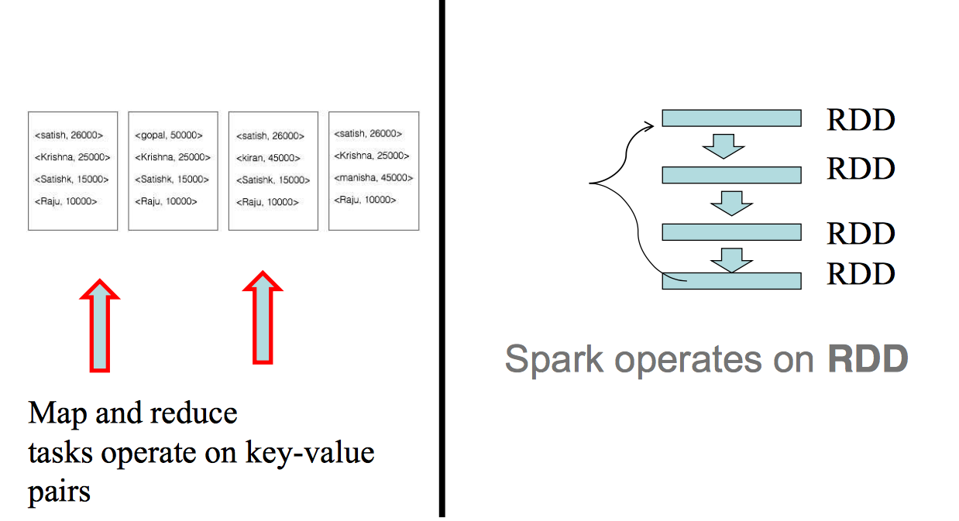
MapReduce vs Spark

Slide 31
RDDs
Partitions are recomputed on failure or cache eviction
Metadata stored for interface:
Partitions – set of data splits associated with this RDD
Dependencies – list of parent RDDs involved in computation
Compute – function to compute partition of the RDD given the parent partitions from the Dependencies
Preferred Locations – where is the best place to put computations on this partition (data locality)
Partitioner – how the data is split into partitions

Slide 32
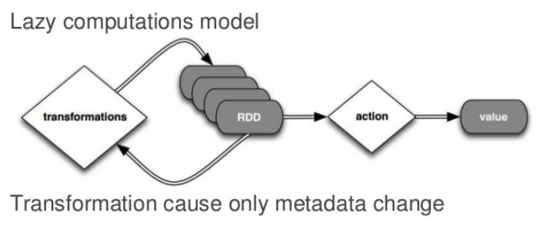
RDDs

Slide 33
DAG
Directed Acyclic Graph – sequence of computations performed on data
Node – RDD partition
Edge – transformation on top of the data
Acyclic – graph cannot return to the older partition
Directed – transformation is an action that transitions data partitions state (from A to B)

Slide 34
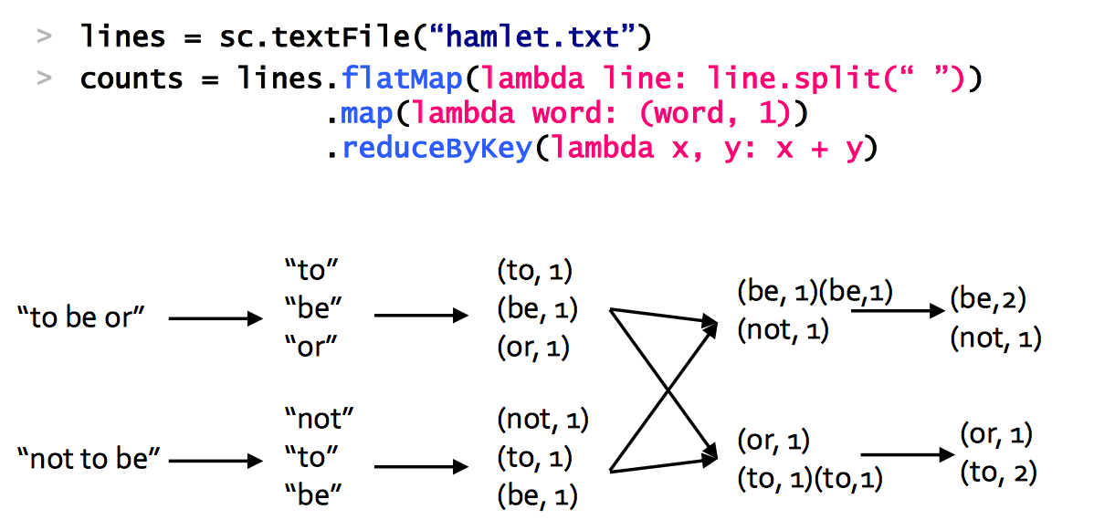
Example: Word Count

Slide 35
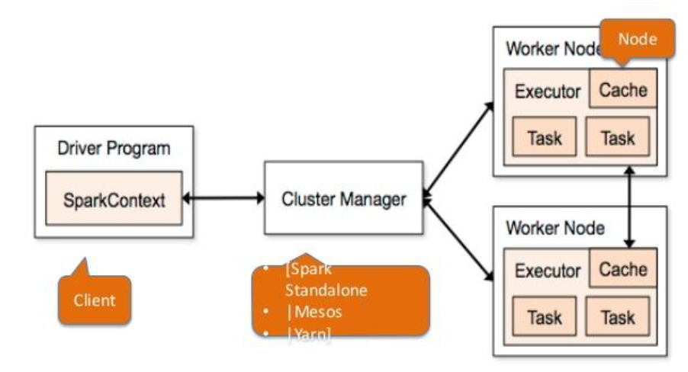
Spark Architecture

Slide 36
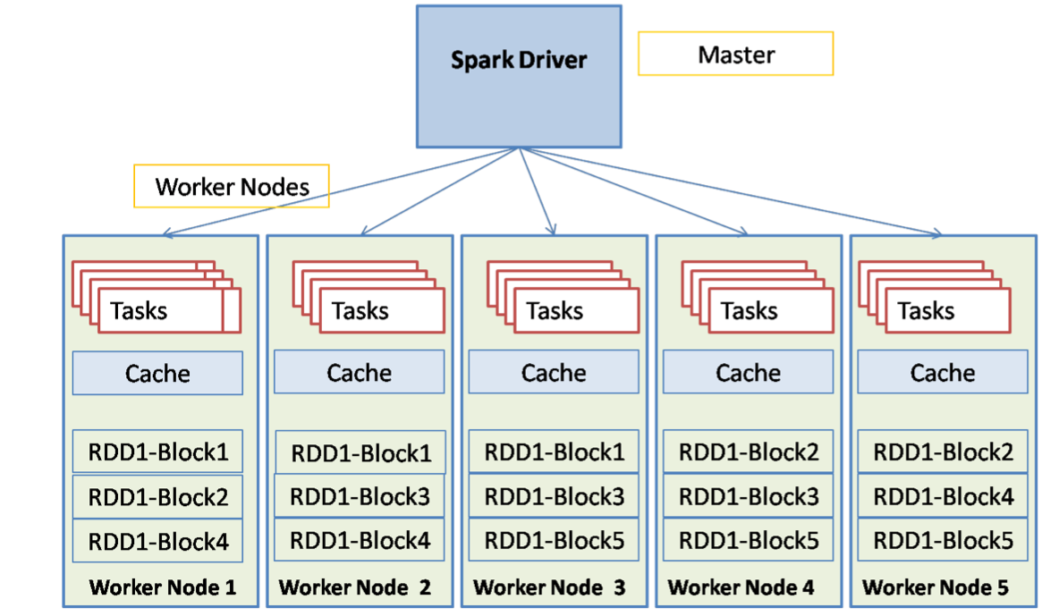
Spark Components

Slide 37
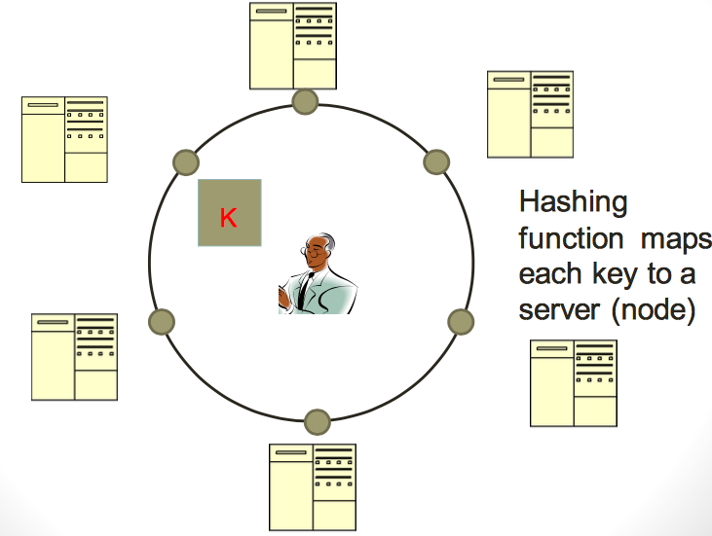
Typical NoSQL architecture

Slide 38
CAP theorem for NoSQL
What the CAP theorem really says: If you cannot limit the number of faults and requests can be directed to any server and you insist on serving every request you receive then you cannot possibly be consistent
How it is interpreted: You must always give something up: consistency, availability or tolerance to failure and reconfiguration

Slide 39
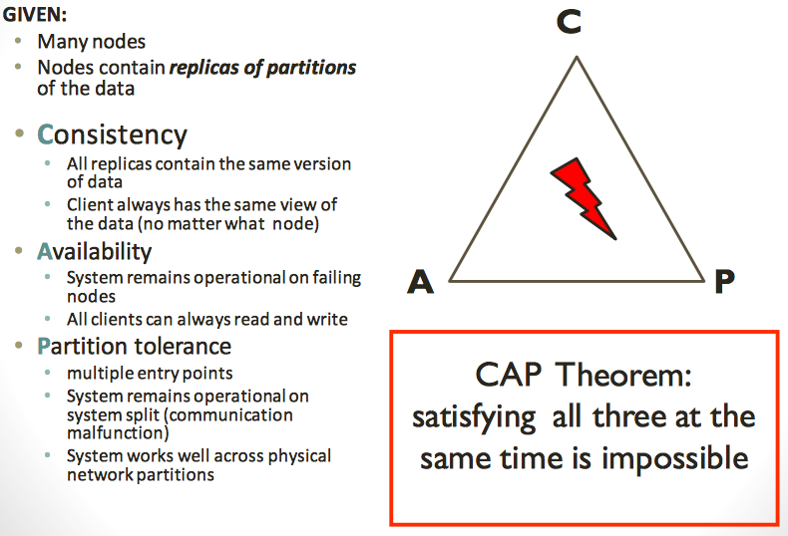
CAP theorem for NoSQL

Slide 40
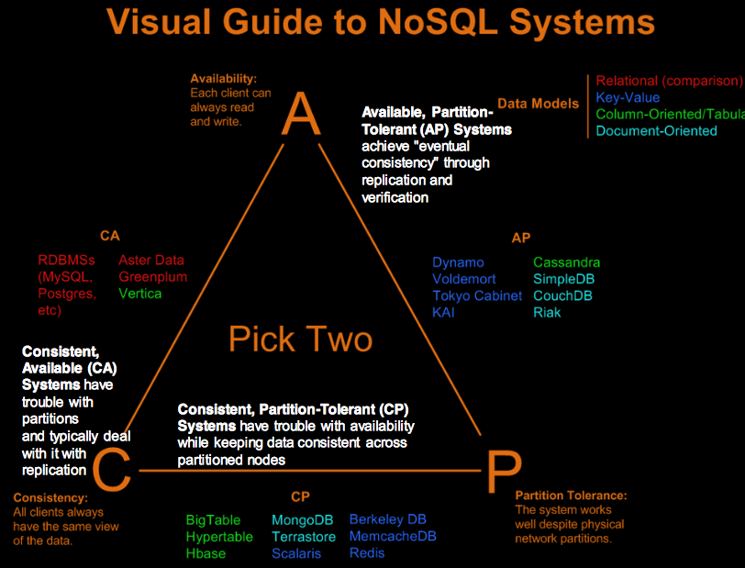

Slide 41
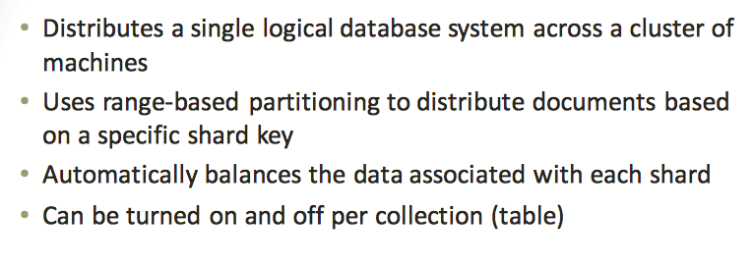
Sharding of data

Slide 42
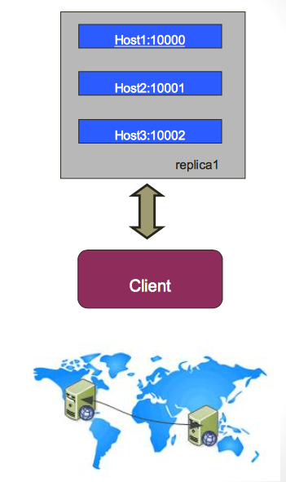
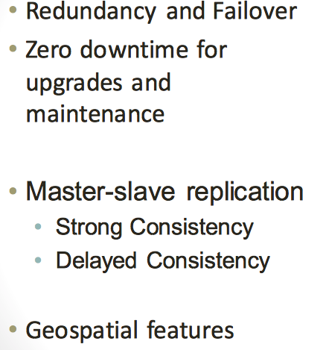
Replica Sets

Slide 43
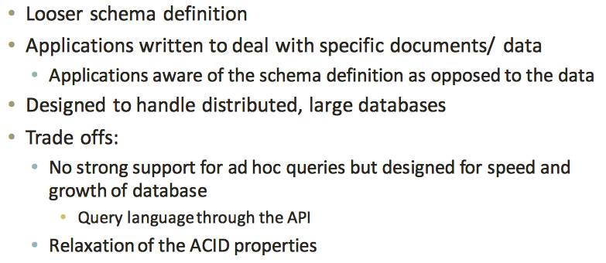
How does NoSQL vary from RDBMS?

Slide 44
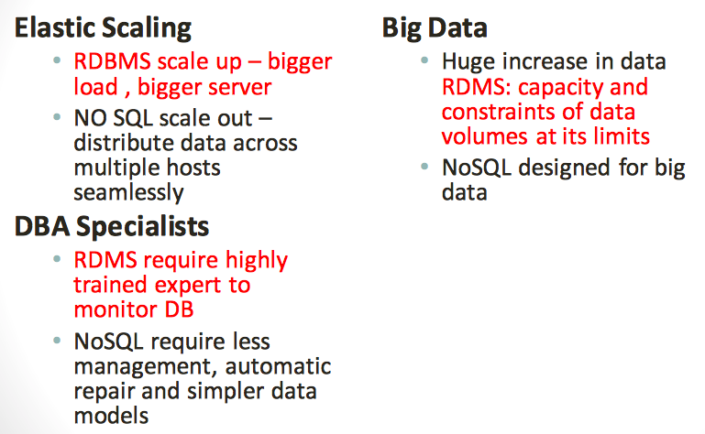
Benefits of NoSQL

Slide 45
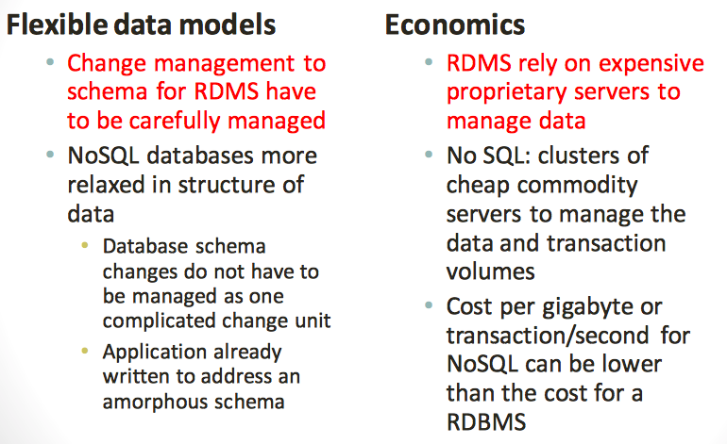
Benefits of NoSQL

Slide 46
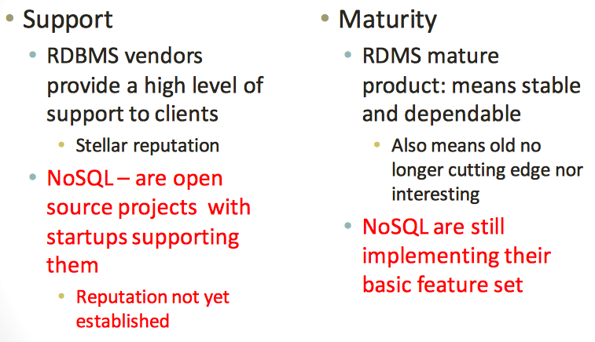
Drawbacks of NoSQL

Slide 47
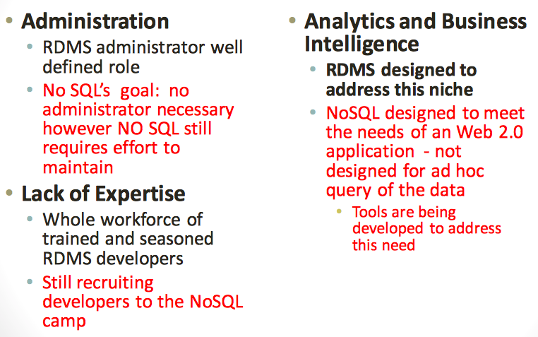
Drawbacks of NoSQL

Slide 48
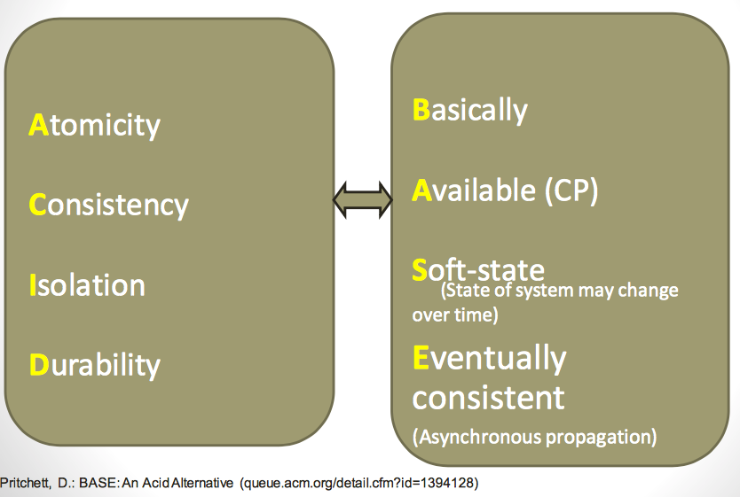
ACID or BASE

